Slide 1
OTIS: Critical Design Review
Mitchell, Sravani, Chacko, Roberto, Jacob
Build a CubeSat 2019

Slide 2
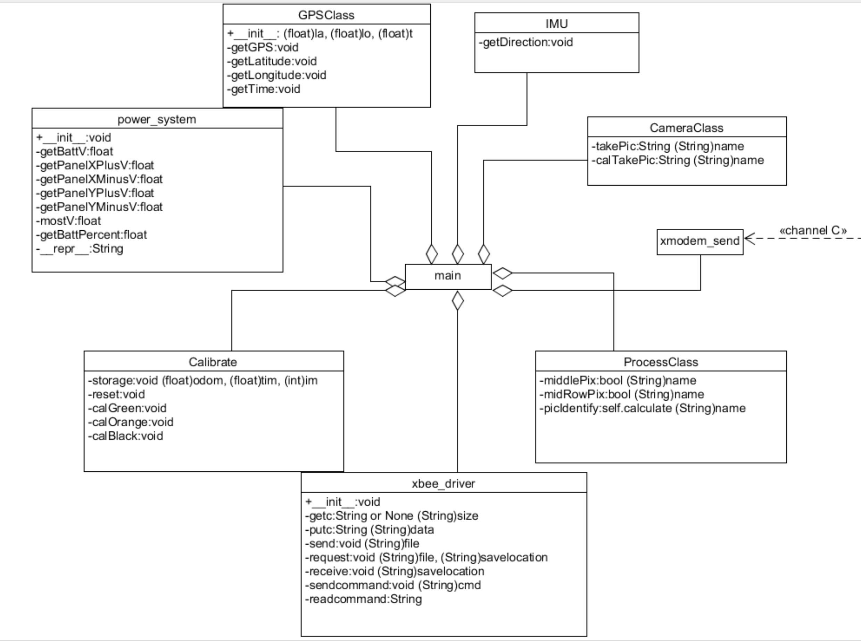
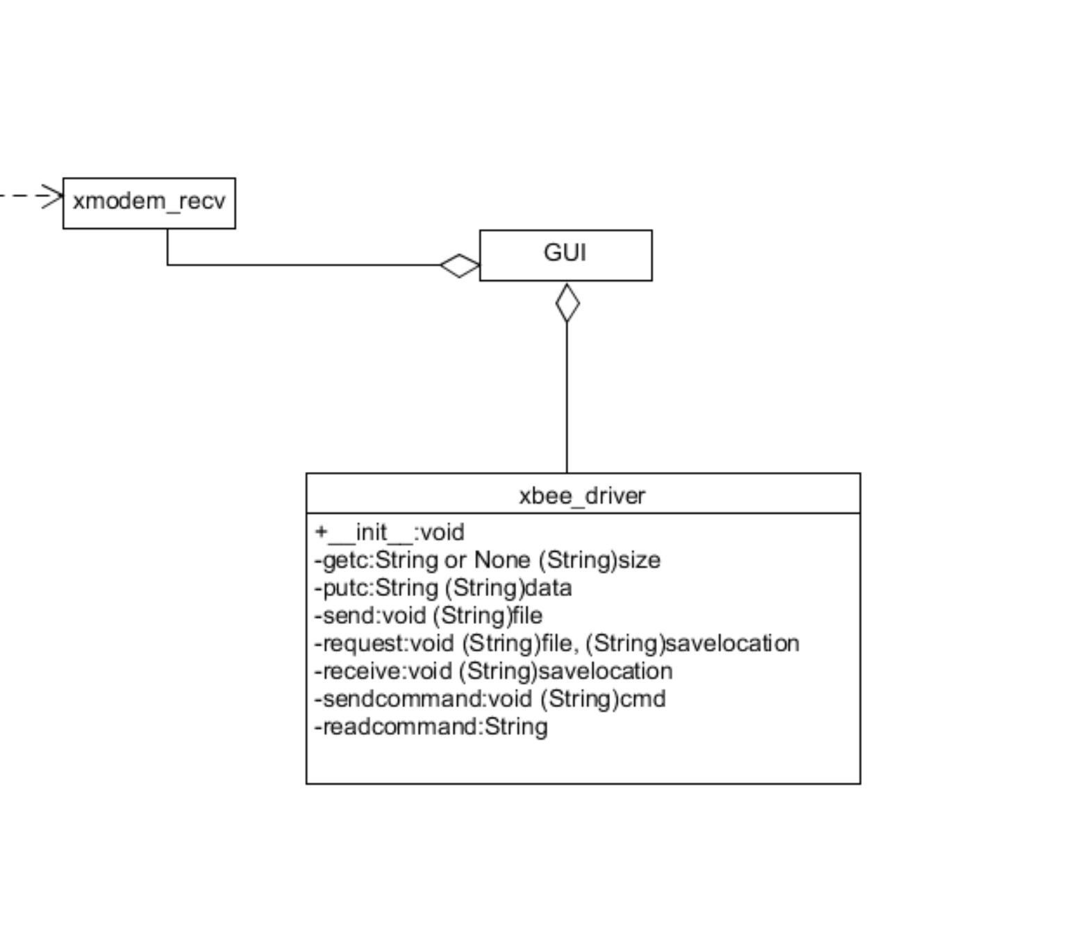

Slide 3
Progress Report: Programming
Progress Report: Design
Each component has own Python class driver.
main.py addresses drivers and runs code onboard to operate the CubeSat
Completed: GPS driver, IMU driver, camera driver, image processing algorithm, power driver implementation, odometer implementation
Incomplete: XBee driver implementation, GUI
(Thursday): panels and rails are marked to cut for 2U form factor
CAD model of layout is ready
Hinge designs for deployable solar panels are complete
Wiring plan is complete.
Ready to build the design on Friday afternoon.

Slide 4
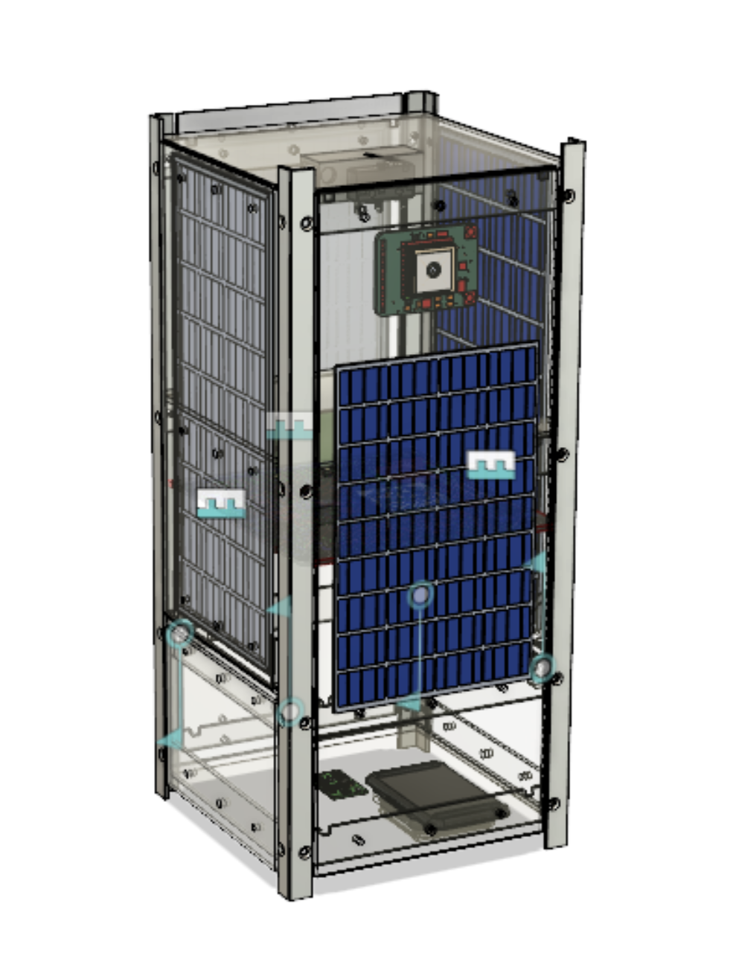
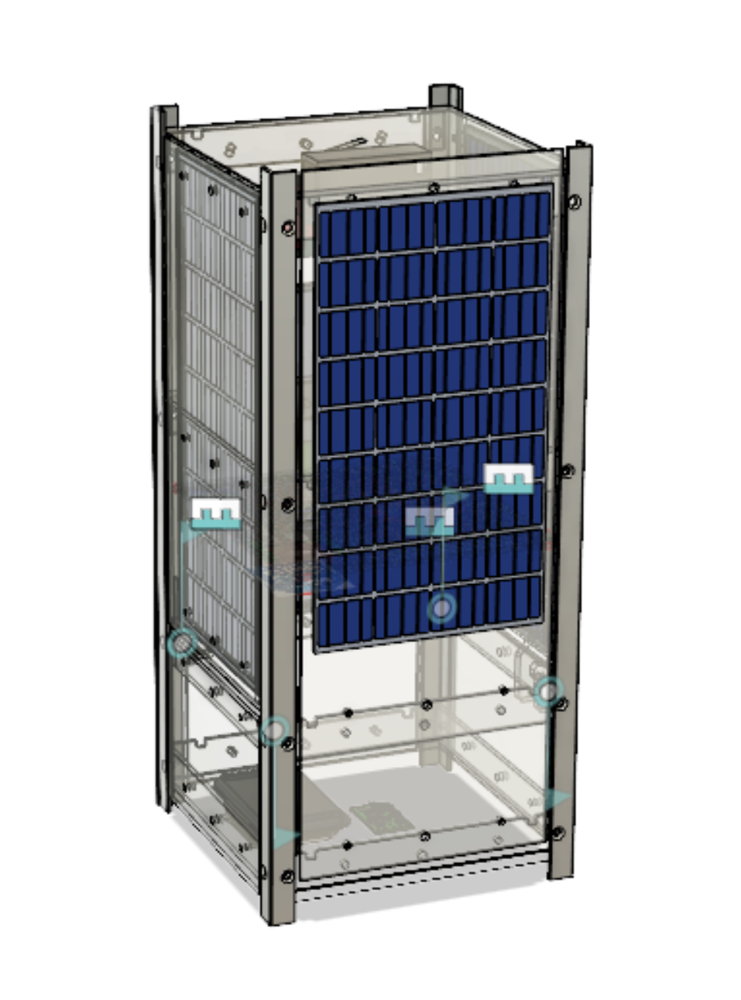

Slide 5
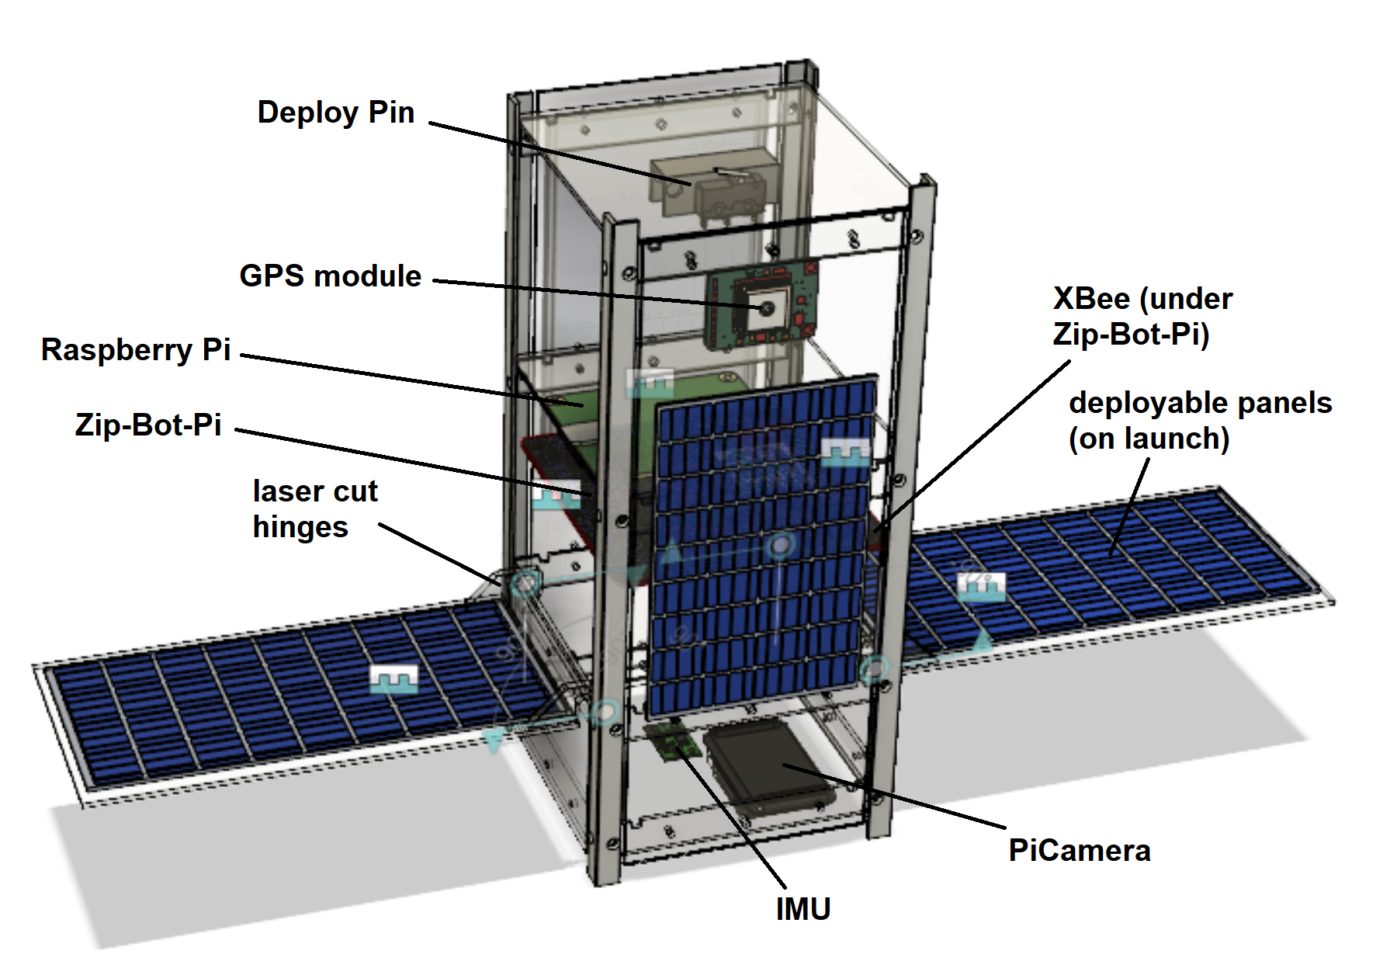

Slide 6
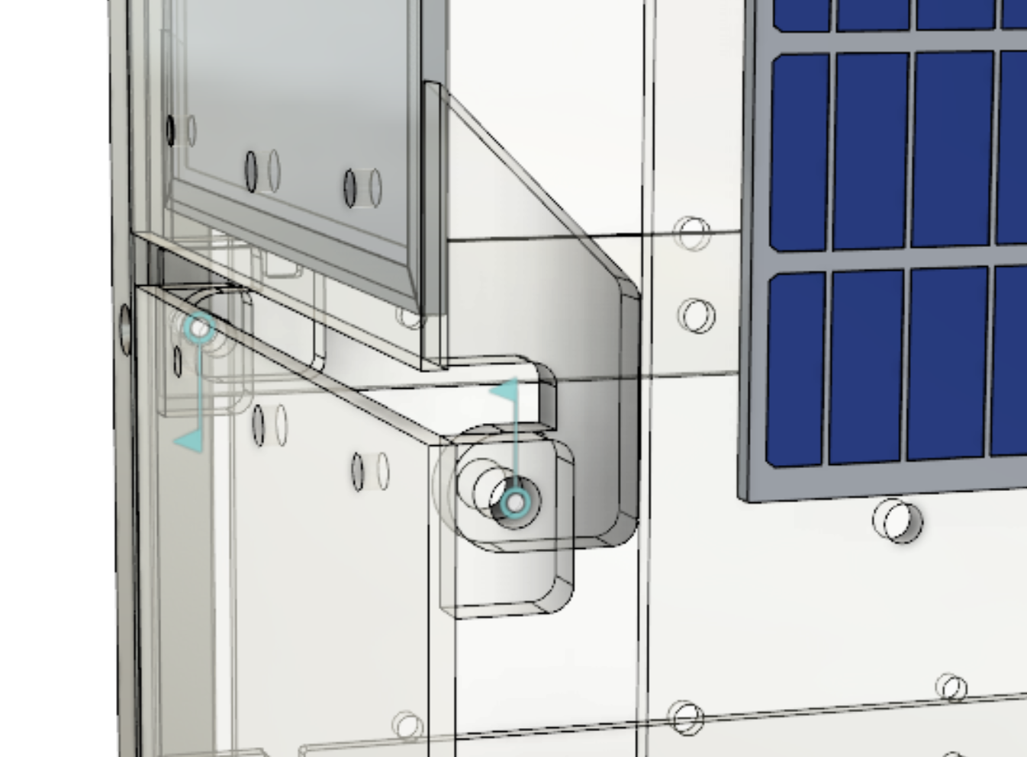
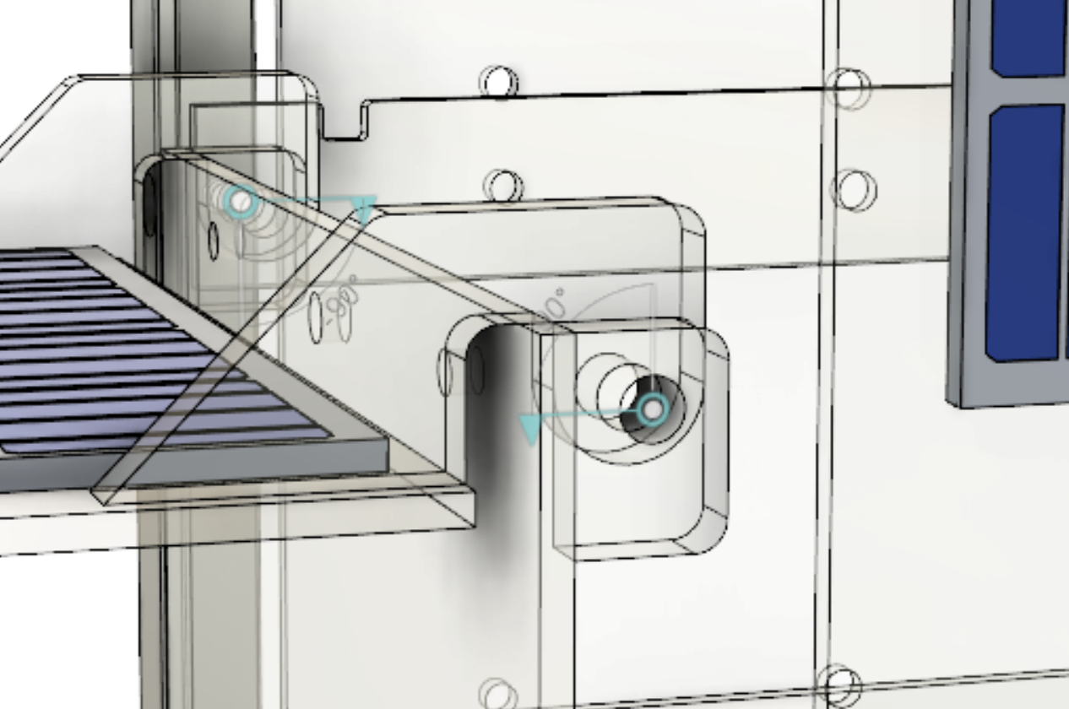

Slide 7
CONOPS
The CubeSat will first power on through the removal of the RBF pin, making the CubeSat “hot”
The solar panels will also “fan out” after the pin is pulled. (see CAD model)
The CubeSat will run the run.py file automatically
Determines if the RBF pin has been removed and the deployment switch has been pressed through GPIO input
The main.py program is executed
On a while loop:
Determine if the CubeSat is on the “AC” leg using IMU Magnetometer
Take a picture every 0.5 seconds
If the picture does NOT have a green pixel in the center AND the picture has green pixels on the border of the image: The image will be analyzed for orange and black pixels onboard, and the percentage of oxidized oil and crude oil will be returned
The usable image will be sent to a ground station Raspberry Pi through the XBees.
After analyzing and sending the image, the Latitude, Longitude, Time, Direction, Battery Percentage, and Battery Voltage will be returned to the console.
Through the odometer, the Distance the CubeSat has travelled will also be returned
If the CubeSat is on the “BC” leg
Using the same algorithm, a picture of the calibration target is analysed to determine shades of Green, Black, and Orange
At the end of the mission, full resolution pictures (1280x720) can be retrieved from the micro-SD card physically

Slide 8
Data Block Diagram:
https://docs.google.com/drawings/d/1T2A1RDonBBERGk_zDmMlk-9EgFTXWQMxKpZRsHHThgA/edit?usp=sharing
Component Block Diagram: https://docs.google.com/drawings/d/1KELM9lIzdQb1be4sWue64g10O_v1IuXGMBn7uNIlD84/edit?usp=sharing
Systems Engineering Chart: https://docs.google.com/drawings/d/1XLuvAcO97MNwX2o3fbB-AkYGSkIpQirZcU_lKCHDS98/edit?usp=sharing
Wiring Diagram:
https://docs.google.com/drawings/d/1rJtjRHam15c3aAeI9dpXzVydAbOtArHPCYTuBrdvyiM/edit?usp=sharing
I/O Diagram:
https://docs.google.com/drawings/d/1bOLlLwjjtJWEihO3DFQ70GJoAuSpb3Vz5FGqlS0-DhA/edit?usp=sharing
Link Budget:
https://docs.google.com/spreadsheets/d/16NM3lBKNR9JyzGBza5iHHE5umGD5a9-4wUMGlZoF8Mc/edit#gid=0

Slide 9
Power Budget
Regulated battery output…………………………………….5V 1A (5W)
Battery capacity…………………………………………………..3.7V 2200mAh (8.14 Wh)
Pi only (idle)..………………………………………………………..5.05V 0.21A (1.06W)
Pi only (Web browser, loading Google.com).………..5.01V 0.45A (2.26 W)
Pi only (synthetic CPU load)............................................4.91V 0.79A (3.87W)
Pi running avionics code, all hardware attached.....5.23V 0.52A (2.72W)
Estimated peak load…………………………………………….5V 0.6A (~3W)
2-hour projected power consumption…………………5V 1.1Ah (5.5Wh, 68% of battery capacity, 20% overestimate)
2-hour worst-case power consumption……………….5V 1.6Ah (7.8Wh, 96% of battery capacity)

Slide 10
Data Budget
Storage: Picture Resolution: 1280x720 pixels x 24 bits/pixel = 22118400 bits or 2.76 MB
40 orbits x 5 pictures per orbit = 200 pictures x 2.76 MB/picture = 552.96 MB
Sent Picture Resolution: 128x128 pixels x 24 bits/pixel = 393216 bits or 49.152 kb
40 orbits x 5 pictures per orbit = 200 pic x 49.152 kb = 9830.4 kb or 9.83 Mb + 2.457 Mb margin
Transfer: XBee data throughput: 6.78 kb/sec
Time to send one picture: 7.25 seconds + 7 seconds (testing)
Time to send extra information: Total: 576 bits +-230 bits = 0.015 sec
GPS: Receiving from Satellites: 632 bits Transferring to Ground Station: 224 bits
IMU: Receiving from Device: 8 bits Transferring to Ground Station: up to 16 bits
Time, Odometer, and onboard processing: 64 bits + 16 bits +128 bits = 208 bits
Battery Percentage and Battery Voltage: 64 bits + 64 bits = 128 bits

Slide 11
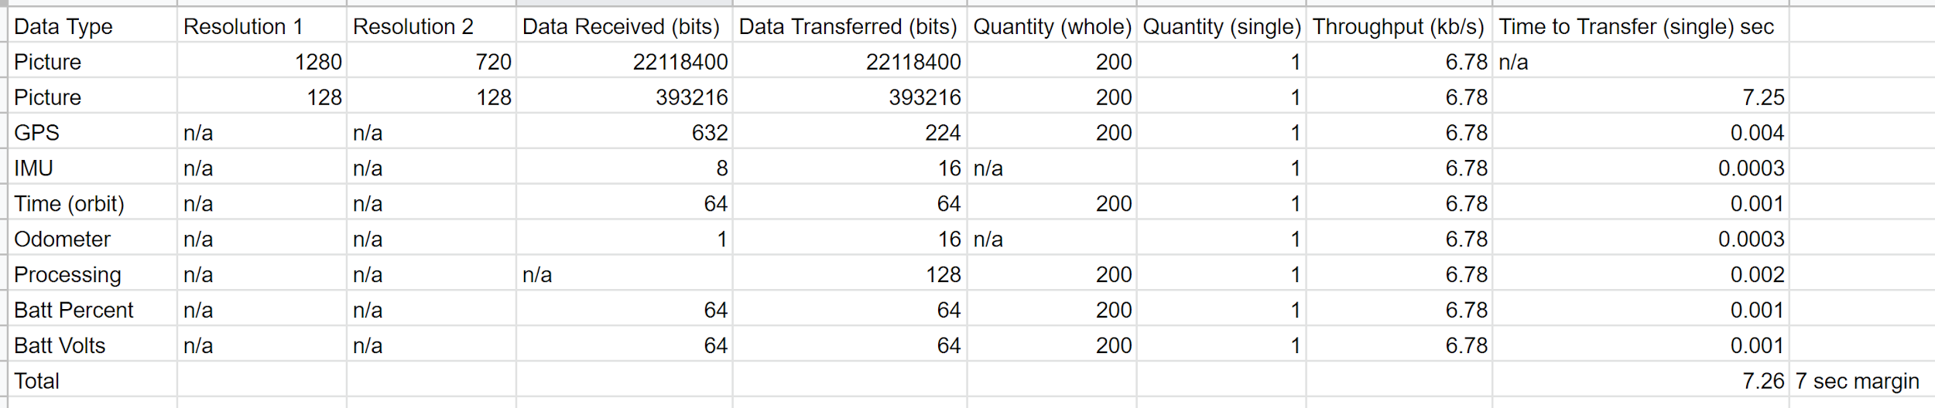
Data Budget Continued

Slide 12
Mass Budget
WEIGHT LIMIT: 2.6 kg
IMU: 0.017 kg
XBee: 0.011 kg
GPS: 0.009 kg
Raspberry Pi 3 Model A+: 0.023 kg
Battery: 0. 077 kg
Camera: 0.015 kg
ZBP: 0.059 kg
Frame 0.4 kg
Cables: 0.050 kg
Solar panels: 0.146 kg
RBF Switch: 0.011 kg
Estimated total: 0.900 kg (15% margin of error)

